Slide 1
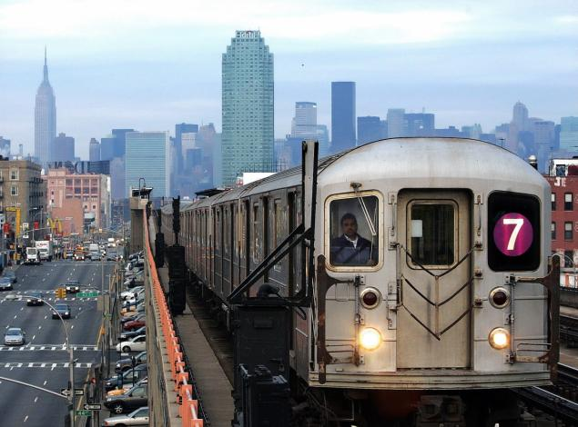
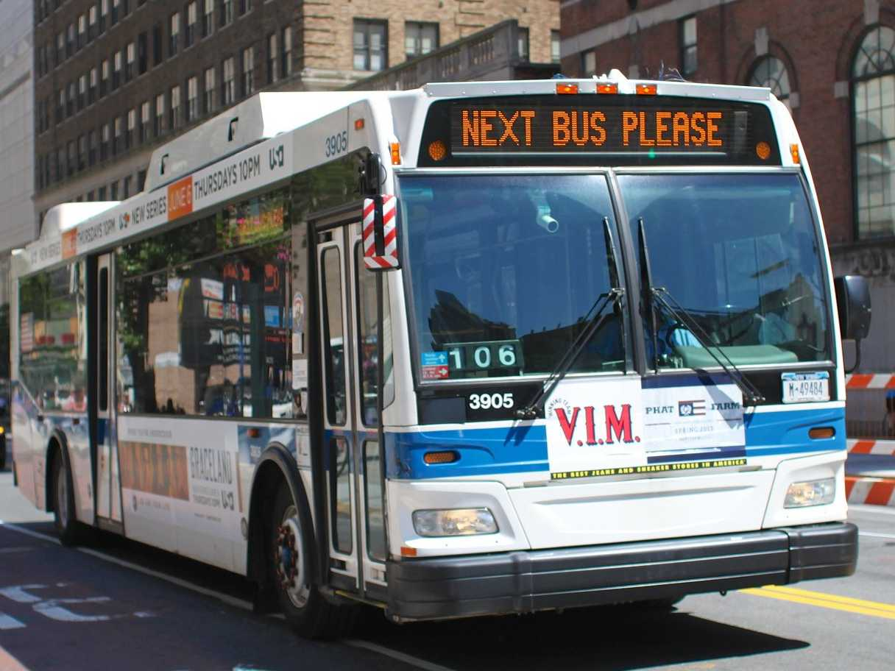
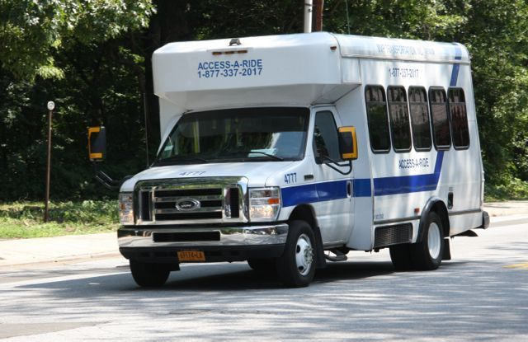
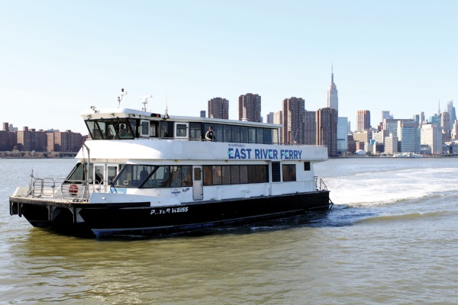

Slide 2


Slide 3
100,000
Notes:
100,000 passengers a day.

Slide 4
500
Notes:
500 illegal van

Slide 5
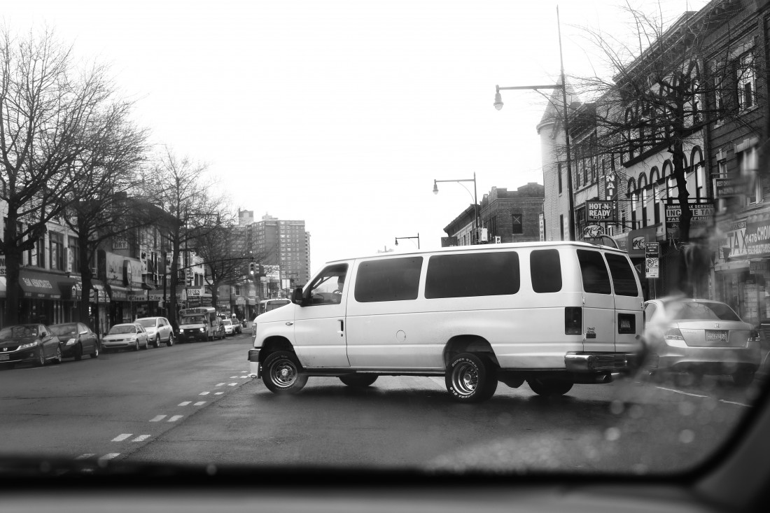
Something

Slide 6
Why do people take dollar vans?

Slide 7
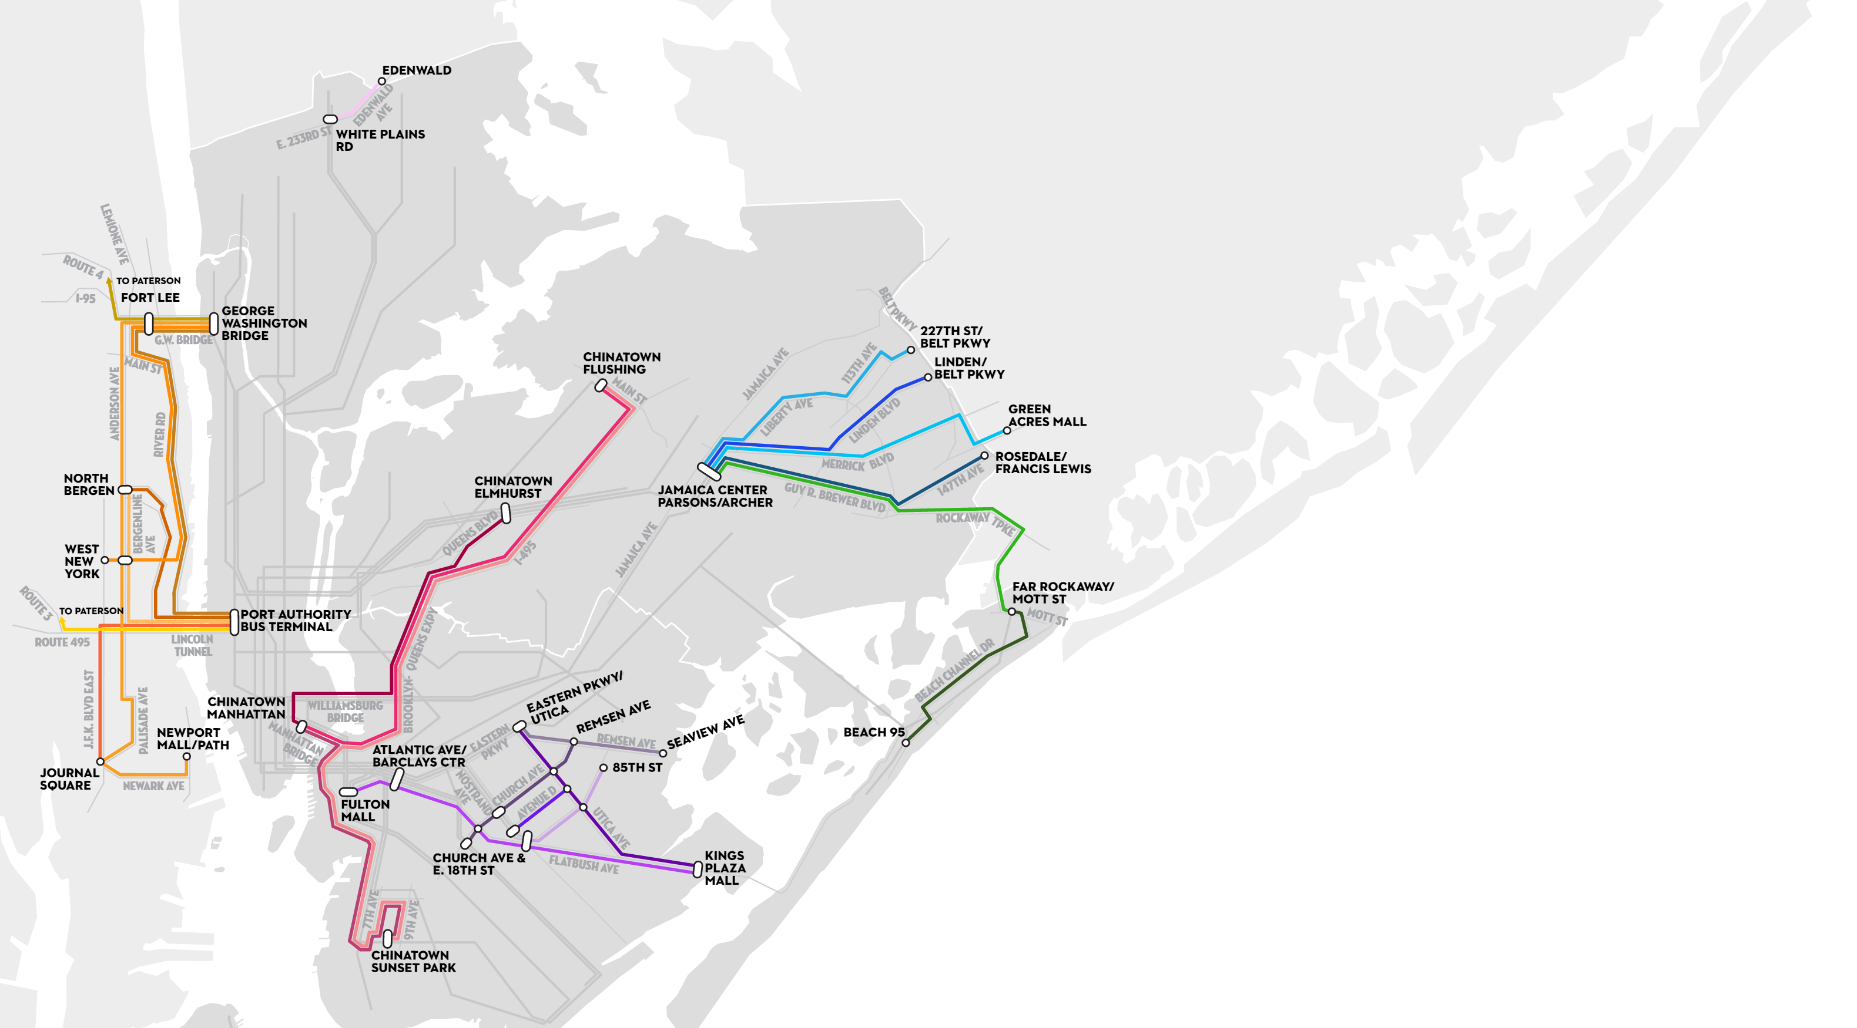
Notes:
Verified Routes by Aaron Reiss

Slide 8
Origins and Destinations
ADD ORIGINS AND DESTINATIONS MAP HERE

Slide 9
Longitudinal Employer-Household Dynamics (LEHD)
American Community Survey
(ACS)

Slide 10
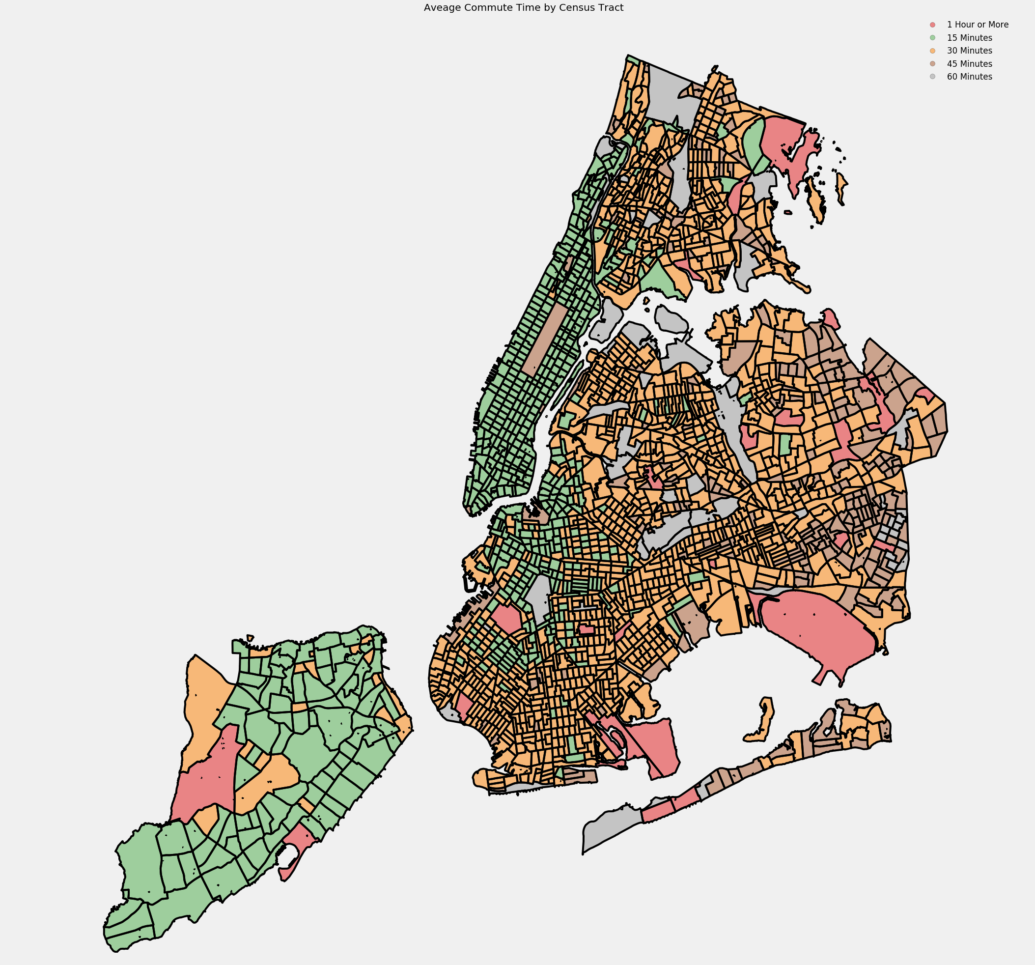
Notes:
Open Trip Planner commute time results

Slide 11
Feature Selection
+
Prediction

Slide 12
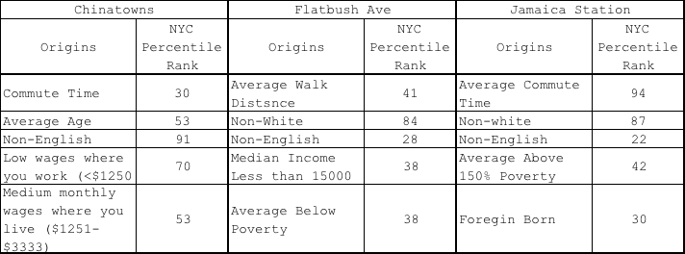
Dollar Van Origin Features
Notes:
Riders are not a Monolith, they very by ‘line’
Chinatown served cultural ties
Flatbush and East New York lines served as economic lifelines

Slide 13
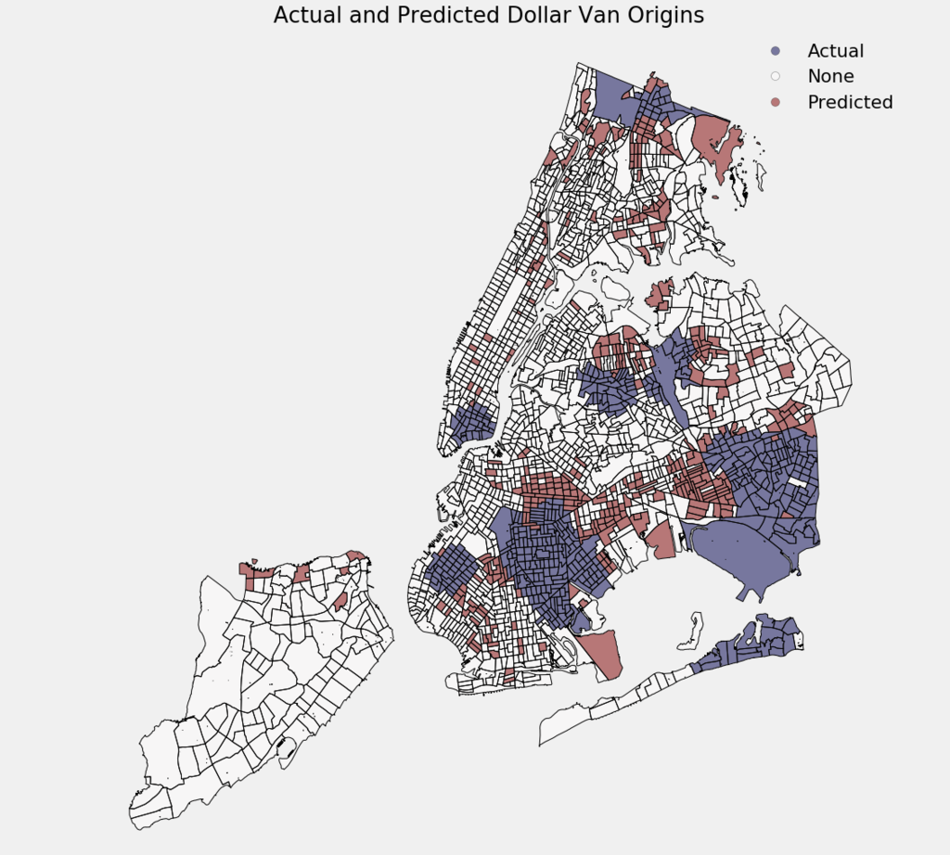
Notes:
Predicted Map

Slide 14
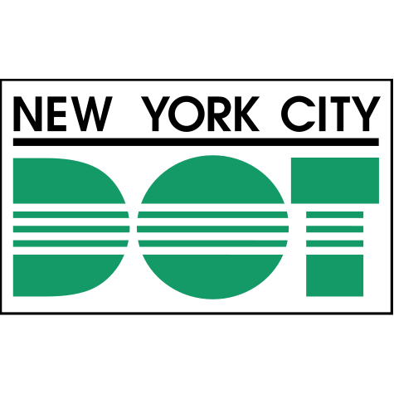
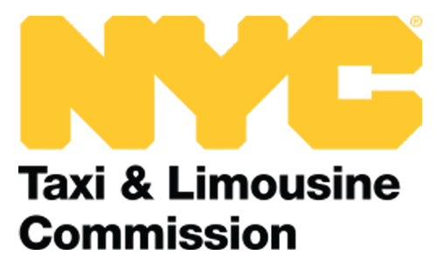
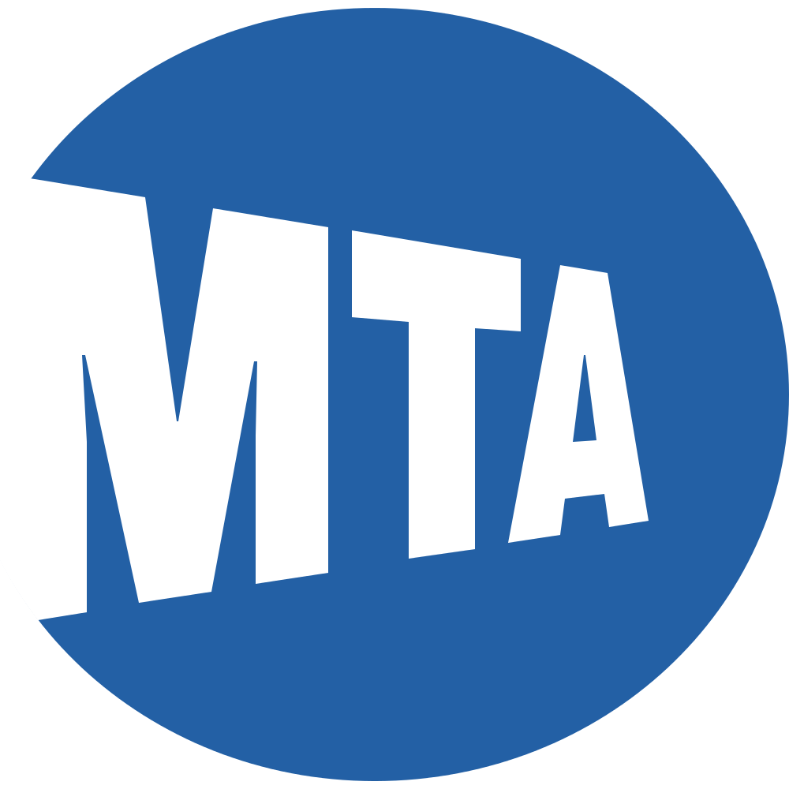
Implications
Notes:
Context of why certain regions are using vans should be included in permitting decisions
The MTA is not well placed to create ‘cultural’ van lines
The MTA should see the outer borough lines as a need for more formal options
Both are serving vital functions and have their place in the ecosystem

Slide 15
Future Work
Notes:
Create a tool for TLC/DOT
Invest in infrastructure in East New York and where our predicative model says their could be dollar van demand

Slide 16
Notes:
Investigate other van lines (NJ, Long Island etc)
Find new van lines to document their routes

